Slide 1
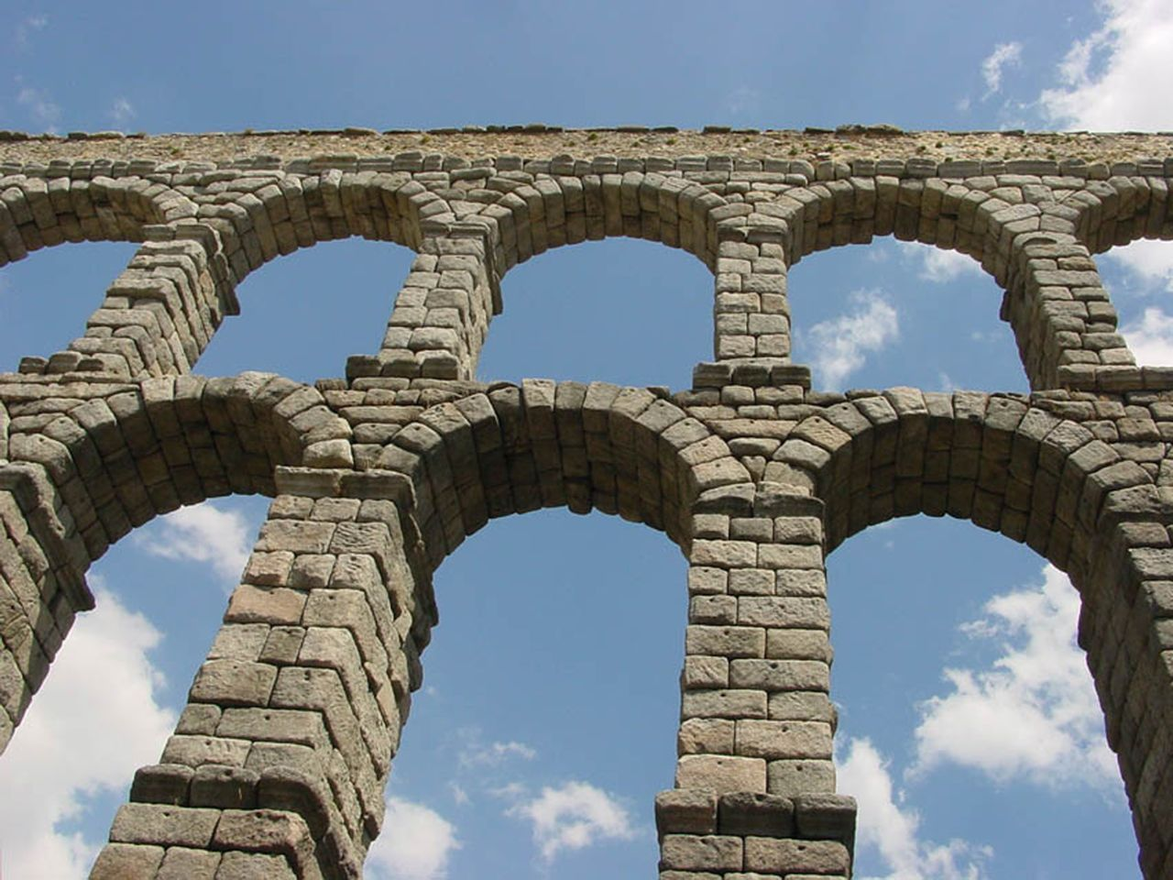
Introduction to Software Engineering
(Engineering Software as a Service §1.1)
David Patterson
Notes:
Very popular topics

Slide 2
Which aspect of the software lifecycle consumes the most resources?
☐
Design
☐
Development
☐
Testing
☐
Maintenance
Notes:
60% of SW total cost over lifecycle is maintenance. We'll have more to say about this later. but ironic that students/courses focus more on "greenfield" SW despite the fact your first project probably won't be, and that more $$ is spent on keeping software useful!

Slide 3
SWE disasters
1985: Therac-25 lethal radiation overdose
Reused SW from machine with HW interlock on machine without it: SW bug => 3 died
1996: Ariane 5 rocket explosion
1996 => wasted $370M
1999: Mars Climate Orbiter disintegration
SW used wrong units (pound-seconds vs. newton-seconds) => wasted $325M
2005: FBI Virtual Case File project abandoned
give up after 5 years of work => wasted $170M
Notes:
SWE clichés
Decollage = takeoff; 350M of sattelites; save memory 16 bit
June 4, 1996 -- Ariane 5 Flight 501. Working code for the Ariane 4 rocket is reused in the Ariane 5, but the Ariane 5's faster engines trigger a bug in an arithmetic routine inside the rocket's flight computer. The error is in the code that converts a 64-bit floating-point number to a 16-bit signed integer. The faster engines cause the 64-bit numbers to be larger in the Ariane 5 than in the Ariane 4, triggering an overflow condition that results in the flight computer crashing.
First Flight 501's backup computer crashes, followed 0.05 seconds later by a crash of the primary computer. As a result of these crashed computers, the rocket's primary processor overpowers the rocket's engines and causes the rocket to disintegrate 40 seconds after launch.
From wired Magazine, History's Worst Software Bugs, 2005, http://www.wired.com/software/coolapps/news/2005/11/69355?currentPage=2
French for “take off” decollage, applause
That is what a SW bug looks like
Worked in Ariane 4. Went faster, higher speed, arithmetic overflow: 64bit FP to 16bit integer

Slide 4
How to Avoid SW Infamy?
Can’t we make building software as predictable in schedule and cost and quality as building a bridge?
If so, what kind of development process to make it predictable?

Slide 5
Software Engineering
Bring engineering discipline to SW
Term coined ~ 20 years after 1st computer
Find SW development methods as predictable in quality, cost, and time as civil engineering
“Plan-and-Document”
Before coding, project manager makes plan
Write detailed documentation all phases of plan
Progress measured against the plan
Changes to project must be reflected in documentation and possibly to plan

Slide 6

1st Development Process: Waterfall (1970)
5 phases of Waterfall “lifecycle”
Requirements analysis & specification
Architectural design
Implementation & Integration
Verification
Operation & Maintenance
Complete one phase before start next one
Why? Earlier catch bug, cheaper it is
Extensive documentation/phase for new people
(Photo by Carola Lauber of SD&M www.sdm.de. Used by permission under CC-BY-SA-3.0.)
Notes:
Like falling down a waterfall
Lots of planning,
6-12 months or more per step
Often steps done by different people
Throw over the wall
Lots of documentataion in case people leave

Slide 7
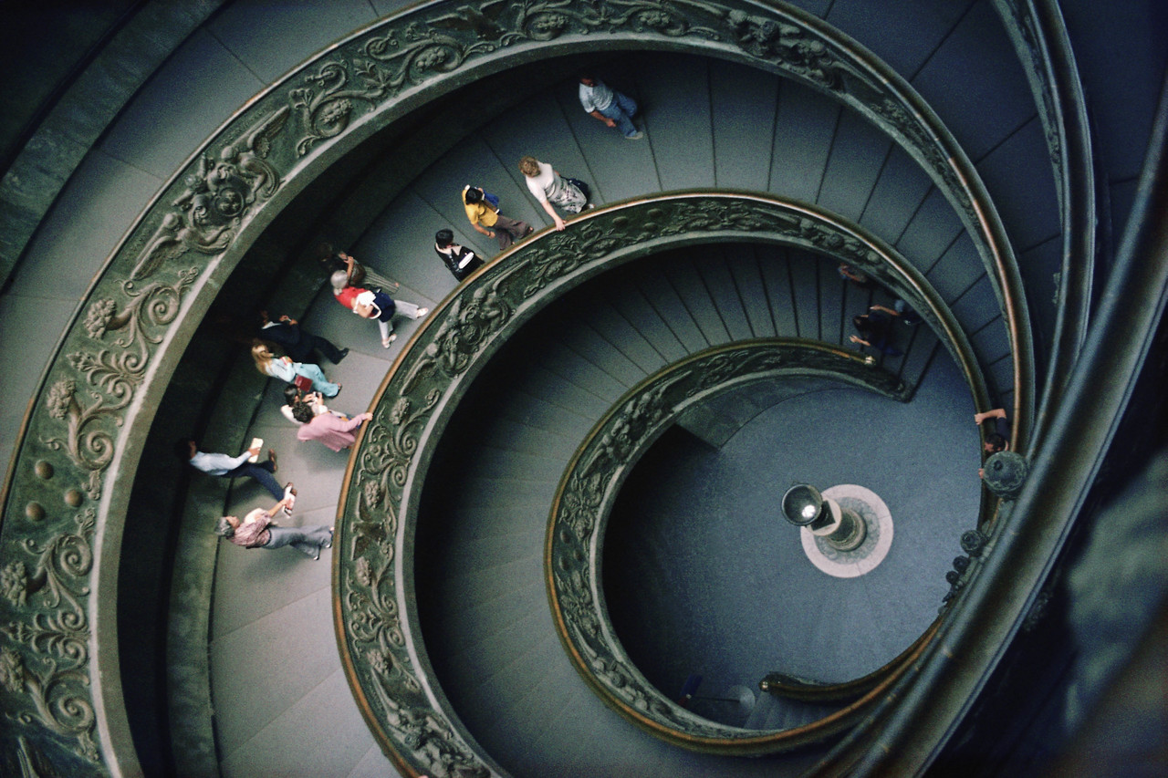
Spiral Lifecycle (1986)
Combine Plan-and-Document with prototypes
Develop plan & requirement documents across each iteration of prototype as needed and evolve with the project

Slide 8
Spiral Lifecycle
(Figure 1.4, Engineering Long Lasting Software by Armando Fox and David Patterson, 2nd Beta edition, 2013.)

Slide 9
Rational Unified Process (RUP) Lifecycle (2003)
(Figure 1.5, Engineering Long Lasting Software by Armando Fox and David Patterson, 2nd Beta edition, 2013.)

Slide 10
RUP Phases
4 Phases (can iterate)
Inception:
business case, set schedule and budget, risk assessment
Elaboration:
use cases, SW archi- tecture, prototype
Construction:
codes and tests the product, 1st release.
Transition:
move to real environment, get customer acceptance

Slide 11
Development processes: Agile (Engineering Long Lasting Software §1.9)
David Patterson
Notes:
earliest ever lecture prep!
follow along download slides

Slide 12
Alternative Process?
How well can Plan-and-document hit the cost, schedule, & quality target?
P&D requires extensive documentation and planning and depends on an experienced manager
Can we build software effectively without careful planning and documentation?
How to avoid “just hacking”?

Slide 13
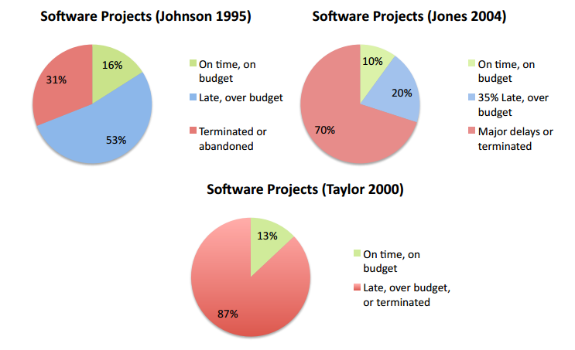
How Well do Plan-and-Document Processes Work?
IEEE Spectrum “Software Wall of Shame”
31 projects (4 from last lecture + 27): lost $17B
3/~500 new development projects on time and budget
Notes:
Figure 1.6: The first study of software projects found that 53% of projects exceeding their budgets by a factor of 2.9 and overshot their schedule by a factor of 3.2 and another 31% of software projects were cancelled before completion (Johnson 1995). The an estimated annual cost in the United States for such software projects was $100B. The second survey of 250 large projects, each with the equivalent of more than a million lines of C code, found similarly disappointing results (Jones 2004). The final survey of members of the British Computer Society found that only 130 of 1027 projects met their schedule and budget. Half of all projects were maintenance or data conversion projects and half new development project, but the successful projects divided into 127 of the former and just 3 of the latter (Taylor 2000).

Slide 14
Agile Manifesto, 2001
“We are uncovering better ways of developing SW by doing it and helping others do it. Through this work we have come to value
Individuals and interactions over processes & tools
Working software over comprehensive documentation
Customer collaboration over contract negotiation
Responding to change over following a plan
That is, while there is value in the items on the right, we value the items on the left more.”
Notes:
Just over 10 years – lots
4 theses
Like Martin Luther nailed his Ninety-Five Theses on 31 October 1517 to the door of the Catholic Church, sparking the Reformation movement in Christianity
Change is not a problem to be solved, but a fact to be coped with

Slide 15
“Extreme Programming” (XP) version of Agile lifecycle
If short iterations are good, make them as short as possible (weeks vs. years)
If simplicity is good, always do the simplest thing that could possibly work
If testing is good, test all the time. Write the test code before you write the code to test.
If code reviews are good, review code continuously, by programming in pairs, taking turns looking over each other’s shoulders.

Slide 16
Agile lifecycle
Embraces change as a fact of life: continuous improvement vs. phases
Developers continuously refine working but incomplete prototype until customers happy, with customer feedback on each Iteration (every ~1 to 2 weeks)
Agile emphasizes Test-Driven Development (TDD) to reduce mistakes, written down User Stories to validate customer requirements, Velocity to measure progress
Notes:
Working but incomplete
More iterations, the more you’ll learn
Write Tests before write code
Customer helps write SW requirements

Slide 17
Agile Then and Now
Controversial in 2001
“… yet another attempt to undermine the discipline of software engineering… nothing more than an attempt to legitimize hacker behavior.”
Steven Ratkin, “Manifesto Elicits Cynicism,”
IEEE Computer, 2001
Accepted in 2013
2012 study of 66 projects found majority using Agile, even for distributed teams

Slide 18
Question: Which statement is TRUE?
☐
A big difference between Agile and P&D is that Agile does not use requirements
☐
A big difference between Agile and P&D is measuring progress against a plan
☐
You can build SaaS apps using Agile, but not with Plan-and-Document
☐
A big difference between Agile and P&D is building prototypes and interacting with customers during the process
Notes:
VertLeftWhiteCheck1
While Agile does not develop extensive requirements documents as does Waterfall, the interactions with customers lead to the creation of requirements as user stories, as we shall see in Chapter 7
Βεχκ: Παρτ οφ χοπινγ ωιτη χηανγε ισ μακινγ χηανγε ατ αρχηιτεχτυραλ λεϖελ –
Both build working but incomplete prototypes that the customer helps evaluate. The difference is that customers are involved every two weeks in Agile versus up to two years in with Spiral.
The answer is measuring progress against a plan

Slide 19
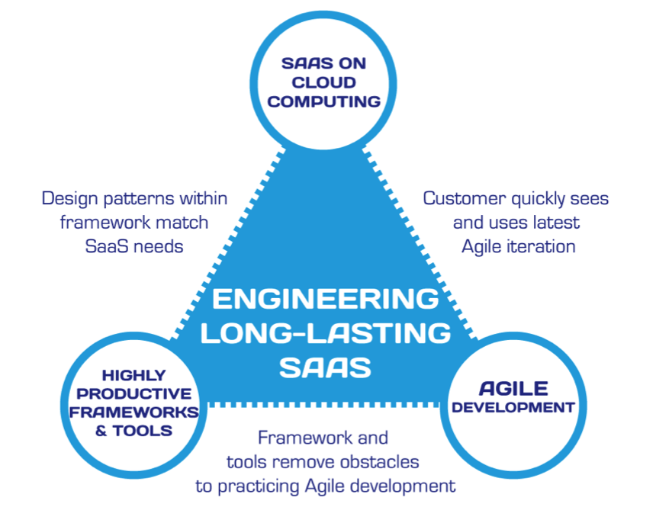
Engineering SW is More Than Programming
(Figure 1.7, Engineering Long Lasting Software by Armando Fox and David Patterson, Beta edition, 2012.)
Notes:
Virtuous triangle: 3 jewels that course is based on
Top: SaaS revolutionize SW, depends on Cloud
Right: Agile, invented independent of other jewels, just a great match
Left: Ruby independent but Rails created to do Agile
Chain between the jewels:
Cloud & Agile: deployed on cloud so customers sees every 2 weeks
Cloud & Frameworks: frameworks have design within framework that matches SaaS needs
Tools & Agile: Not preaching, but tools to implement Agile principles - TDD

Slide 20
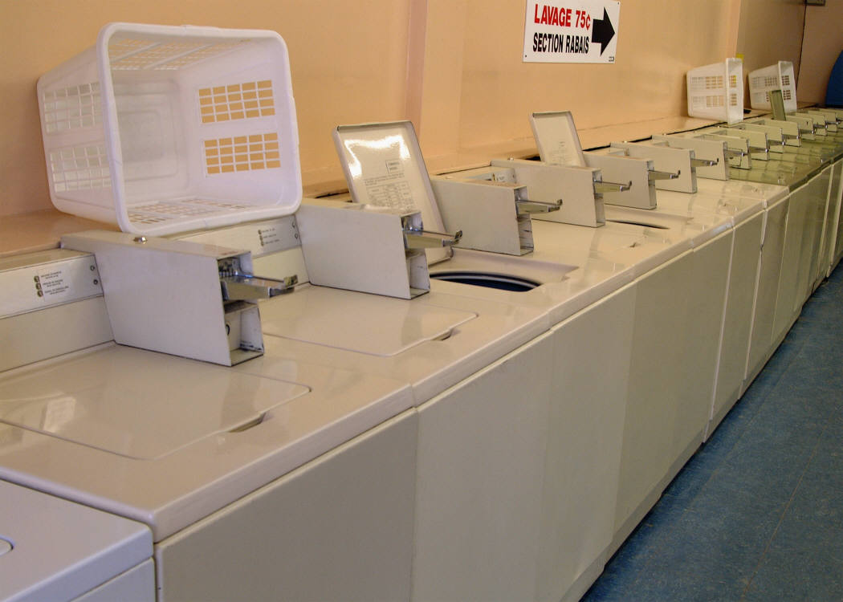
Software as a Service (SaaS) and Service-Oriented Architecture (SOA)
(Engineering Software as a Service §1.2-1.3)
David Patterson
Notes:
Very popular topics
Rent like using doing your laundry in a service

Slide 21

2002: Amazon shall use SOA!
“All teams will henceforth expose their data and functionality through service interfaces.”
“Teams must communicate with each other through these interfaces.”
“There will be no other form of interprocess communication allowed: no direct linking, no direct reads of another team's data store, no shared-memory model, no back-doors whatsoever. The only communication allowed is via service interface calls over the network.”
Notes:
Blogger at Google used to be at Amazon
Internal blog, for Google rant how screwed up company was
External blog for public
Mixed them up, and we put it into the book before he deleted entry
Amazon for all its weaknesses, does SOA
Google, for all its strengths, doesn’t get SOA
Started as silo’d sw in 1995, then 7 years later switched to SOA via directive from Bezos, CEO and founder of Amazon,
BS in CS Princeton
Blogger claims one of 7 points is false; we’ll figure out which at end

Slide 22
CEO: Amazon shall use SOA!
“It doesn't matter what [API protocol] technology you use.”
“Service interfaces, without exception, must be designed from the ground up to be externalizable. That is to say, the team must plan and design to be able to expose the interface to developers in the outside world. No exceptions.”
“Anyone who doesn't do this will be fired.”
“Thank you; have a nice day!”
Notes:
Why should Iisten to CEO? What does he know? Don’t you read Dilbert? I’m smarter than the CEO. What should I follow this email?
False was 7. Bezos doesn’t care about your day. He got them with “fired”
5 points is one of best descriptions of SOA; everything must use API
Facebook too; Facebook platform 3 years later, switched from monolithic silo’d to facebook (Facebook Platform)
(Google doesn’t get it – Google Groups could only watch what others could do)

Slide 23
Bookstore: Silo
Internal subsystems can share data directly
Review access user profile
All subsystems inside single API (“Bookstore”)
(Figure 1.2, Engineering Software as a Service by Armando Fox and David Patterson, 2nd Beta edition, 2013.)
Notes:
Start with Silo’d version – natural to do
Shared memory, no extra overhead
the reviews subsystem can get user profile info out of the users subsystem
3 independent services inside the silo

Slide 24
Bookstore: SOA
Subsystems independent, as if in separate datacenters
Review Service access User Service API
Can recombine to make new service (“Favorite Books”)
Notes:
Creates another app – group’s favorite books app from standard bookstore just another combination
Even though all inside same datacenter, SW written as if in different ones
No service can access another services data – must go through API of service
Note not a layered model of software, but a network connection

Slide 25

Cloud Computing
(Engineering Software as a Service §1.4)
David Patterson

Slide 26
Ideal hardware infrastructure for SaaS?
SaaS’s 3 demands on infrastructure
Communication
Allow customers to interact with service
Scalability
Fluctuations in demand during + new services to add users rapidly
Dependability
Service & communication available 24x7
Notes:
Scalability for holidays
Has to work all the time – since only in one place

Slide 27
Software Quality
Product quality (in general): “fitness for use”
Business value for customer and manufacturer
Quality Assurance : processes/standards => high quality products & to improve quality
Software quality:
Satisfies customers’ needs—easy to use, gets correct answers, does not crash, …
Be easy for developer to debug and enhance
Software QA: ensure quality and improve processes in SW organization

Slide 28
Assurance
Verification: Did you build the thing right?
Did you meet the specification?
Validation: Did you build the right thing?
Is this what the customer wants?
Is the specification correct?
Hardware focus generally Verification
Software focus generally Validation
Testing to Assure Software Quality
Notes:
HW on verification
SW on validation

Slide 29
Exhaustive testing is infeasible
Divide and conquer: perform different tests at different phases of SW development
Upper level doesn’t redo tests of lower level
Coverage: various measurements of what % of system is “exercised” by test suite
Test levels
System or acceptance test: integrated program meets its specifications
Integration test: interfaces between units have consistent assumptions, communicate correctly
Module or functional test: across individual units
Unit test: single method does what was expected
Notes:
1 ns test, 64-bit variable, 2^64 ns = 500 years!
e.g., unit testing works within a single class and functional testing works across classes
Unit test: single method does what was expected
Module or functional test: across individual units (within a class)
Integration test: interfaces between units have consistent assumptions, communicate correctly
System or acceptance test: integrated program meets its specifications

Slide 30
And in Conclusion: §§1.1-1.7
SaaS less hassle for developers and users
Service Oriented Architecture makes it easy to reuse current code to create new apps
Scale led to savings/CPU => reduced cost of Cloud Computing => Utility Computing
Testing to assure software quality, which means good for customer and developer
Developer Productivity: Conciseness, Synthesis, Reuse, and Tools
Notes:
1st day of school; we think its interesting, remember these happy moment; learn about future software
Something is not what you’re expecting, to develop great SW

